Slide 1
Department of Applied Mathematics and Computational Sciences
III Sem M.Sc.Software Systems
Transform Techniques
Dr. V. Suresh kumar

Slide 2
Transform of Derivative

Slide 3
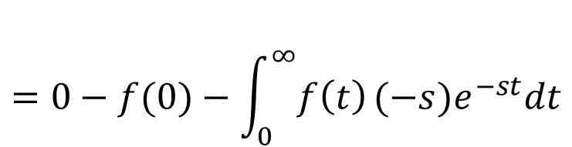
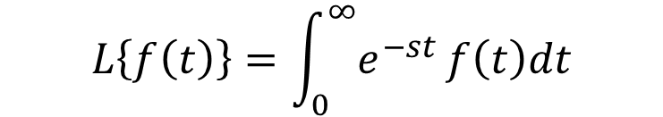
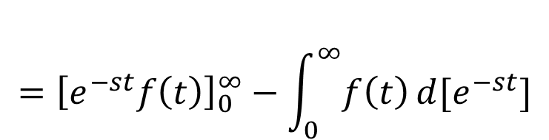
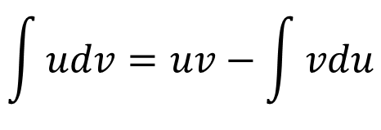
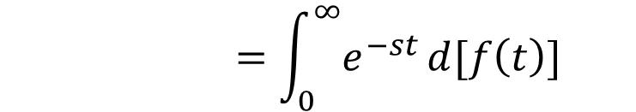
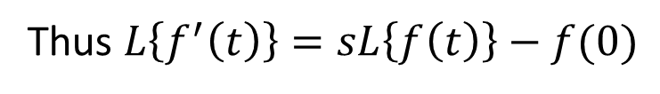
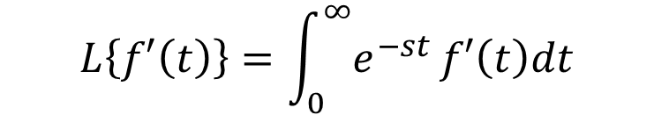
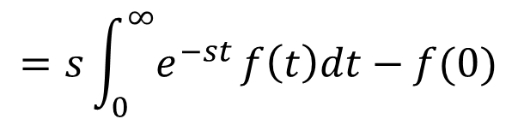
Statement
If $L\left\{f\left(t\right)\right\}=F(s)$ then $L\left\{f^{′}\left(t\right)\right\}=sL\left\{f\left(t\right)\right\}−f(0)$
Proof:
We have
$$L\left\{f\left(t\right)\right\}=\int_{0}^{∞}{e^{−st}}f\left(t\right)dt$$
$$\int{udv}=uv−\int{vdu}$$
$$L\left\{f′\left(t\right)\right\}=\int_{0}^{∞}{e^{−st}}f′\left(t\right)dt$$
$$=\int_{0}^{∞}{e^{−st}}d[f\left(t\right)]$$
$$={\left[e^{−st}f\left(t\right)\right]}_{0}^{∞}−\int_{0}^{∞}{f\left(t\right)}d[e^{−st}]$$
$$=s\int_{0}^{∞}{e^{−st}}f\left(t\right)dt−f(0)$$
$$=0−f(0)−\int_{0}^{∞}{f\left(t\right)}(−s)e^{−st}dt$$
Thus $L\left\{f^{′}\left(t\right)\right\}=sL\left\{f\left(t\right)\right\}−f(0)$

Slide 4





Note:
$$1. L\left\{f^{′}\left(t\right)\right\}=sL\left\{f\left(t\right)\right\}−f(0)$$
$$L\left\{f^{′′}\left(t\right)\right\}=sL\left\{f′\left(t\right)\right\}−f′(0)$$
$$=s\left\langle sL\left\{f\left(t\right)\right\}−f(0) \right\rangle −f′(0)$$
$$=s^{2}L\left\{f\left(t\right)\right\}−sf\left(0\right)−f′(0)$$
$$2.L\left\{f^{′′}\left(t\right)\right\}=s^{2}L\left\{f\left(t\right)\right\}−sf\left(0\right)−f′(0)$$
Similarly
$$3.L\left\{f^{′′′}\left(t\right)\right\}=s^{3}L\left\{f\left(t\right)\right\}−s^{2}f\left(0\right)−sf^{′}\left(0\right)−f′′(0)$$
This can be extended for $n^{th}$ ordered derivative

Slide 5
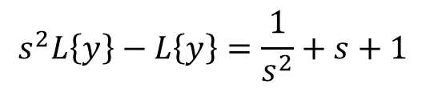

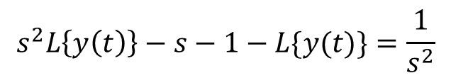
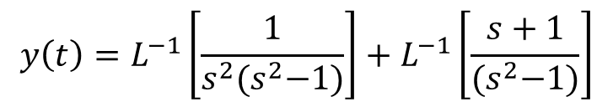
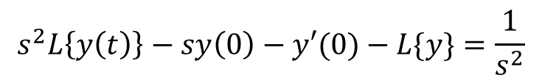
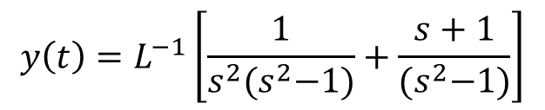

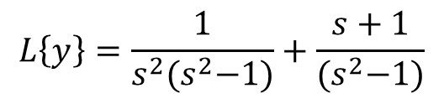

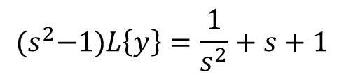
Problems
1. Solve the Initial Value Problem (IVP) $y^{′′}−y=t, y\left(0\right)=1, y^{′}\left(0\right)=1$
Sol:
$$s^{2}L\left\{y\right\}−L\left\{y\right\}=\frac{1}{s^{2}}+s+1$$
Given
$$y^{′′}−y=t$$
$${(s}^{2}−1)L\left\{y\right\}=\frac{1}{s^{2}}+s+1$$
Taking Laplace Transform on both sides
$$L\left\{y\right\}=\frac{1}{s^{2}{(s}^{2}−1)}+\frac{s+1}{{(s}^{2}−1)}$$
$${L\{y}^{′′}−y\}=L\{t\}$$
$$y\left(t\right)=L^{−1}\left[\frac{1}{s^{2}{(s}^{2}−1)}+\frac{s+1}{{(s}^{2}−1)}\right]$$
$${L\{y}^{′′}\}−L\{y\}=L\{t\}$$
$$s^{2}L\left\{y\left(t\right)\right\}−sy\left(0\right)−y′(0)−L\{y\}=\frac{1}{s^{2}}$$
$$y\left(t\right)=L^{−1}\left[\frac{1}{s^{2}{(s}^{2}−1)}\right]+L^{−1}\left[\frac{s+1}{{(s}^{2}−1)}\right]$$
(1)
$$s^{2}L\left\{y\left(t\right)\right\}−s−1−L\{y(t)\}=\frac{1}{s^{2}}$$

Slide 6

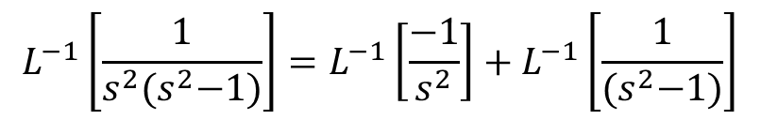


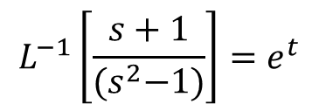

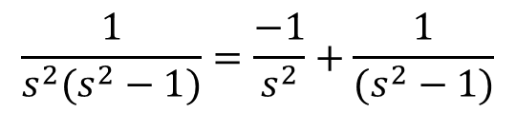
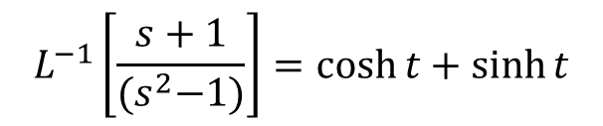
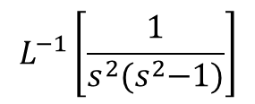
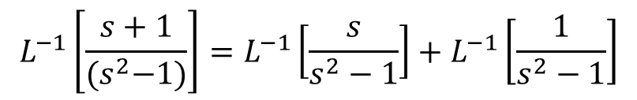
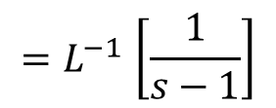

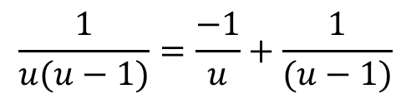
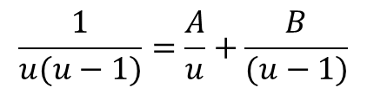
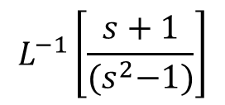

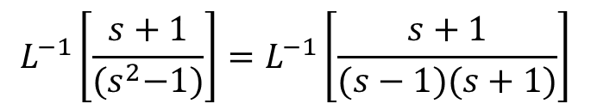
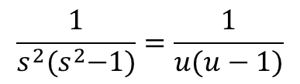

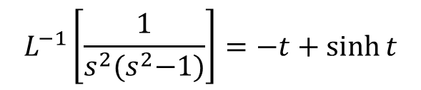

No. 1 cont…
$$\frac{1}{u(u−1)}=\frac{−1}{u}+\frac{1}{(u−1)}$$
Substitute (2) and (3) in (1)
$$L^{−1}\left[\frac{1}{s^{2}{(s}^{2}−1)}\right]$$
To find
$$\frac{1}{s^{2}(s^{2}−1)}=\frac{−1}{s^{2}}+\frac{1}{(s^{2}−1)}$$
$$y\left(t\right)=−t+\sinh{t+\cosh{t}+\sinh{t}}$$
Put $u=s^{2}$
$$L^{−1}\left[\frac{1}{s^{2}{(s}^{2}−1)}\right]=L^{−1}\left[\frac{−1}{s^{2}}\right]+L^{−1}\left[\frac{1}{{(s}^{2}−1)}\right]$$
(OR)
$$\frac{1}{s^{2}{(s}^{2}−1)}=\frac{1}{u(u−1)}$$
$$L^{−1}\left[\frac{1}{s^{2}{(s}^{2}−1)}\right]=−t+\sinh{t}$$
$$\frac{1}{u(u−1)}=\frac{A}{u}+\frac{B}{(u−1)}$$
(2)
$$L^{−1}\left[\frac{s+1}{{(s}^{2}−1)}\right]=L^{−1}\left[\frac{s+1}{(s−1)(s+1)}\right]$$
$$L^{−1}\left[\frac{s+1}{{(s}^{2}−1)}\right]$$
$$1=A\left(u−1\right)+Bu$$
To find
$${=L}^{−1}\left[\frac{1}{s−1}\right]$$
Put $u=0$
$$L^{−1}\left[\frac{s+1}{{(s}^{2}−1)}\right]=L^{−1}\left[\frac{s}{s^{2}−1}\right]+L^{−1}\left[\frac{1}{s^{2}−1}\right]$$
$$L^{−1}\left[\frac{s+1}{{(s}^{2}−1)}\right]=e^{t}$$
$$A=−1$$
Put $u=1$
$$L^{−1}\left[\frac{s+1}{{(s}^{2}−1)}\right]=\cosh{t}+\sinh{t}$$
(3)
$$B=1$$
$$y\left(t\right)=−t+\sinh{t+e^{t} }$$
(1)

Slide 7
Problems cont…
2.
Sol:

Slide 8
Homework problems
Solve the following IVPs
1.
2.
3.
4.
5.

Slide 9


